Slide 1
Story Lining Chemical Reactions
ISTA 2019

Slide 2
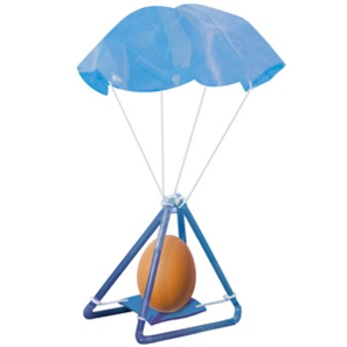
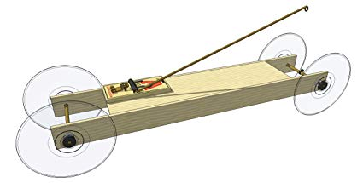
Engineering in Schools

Slide 3
Engineering it real life

Slide 4
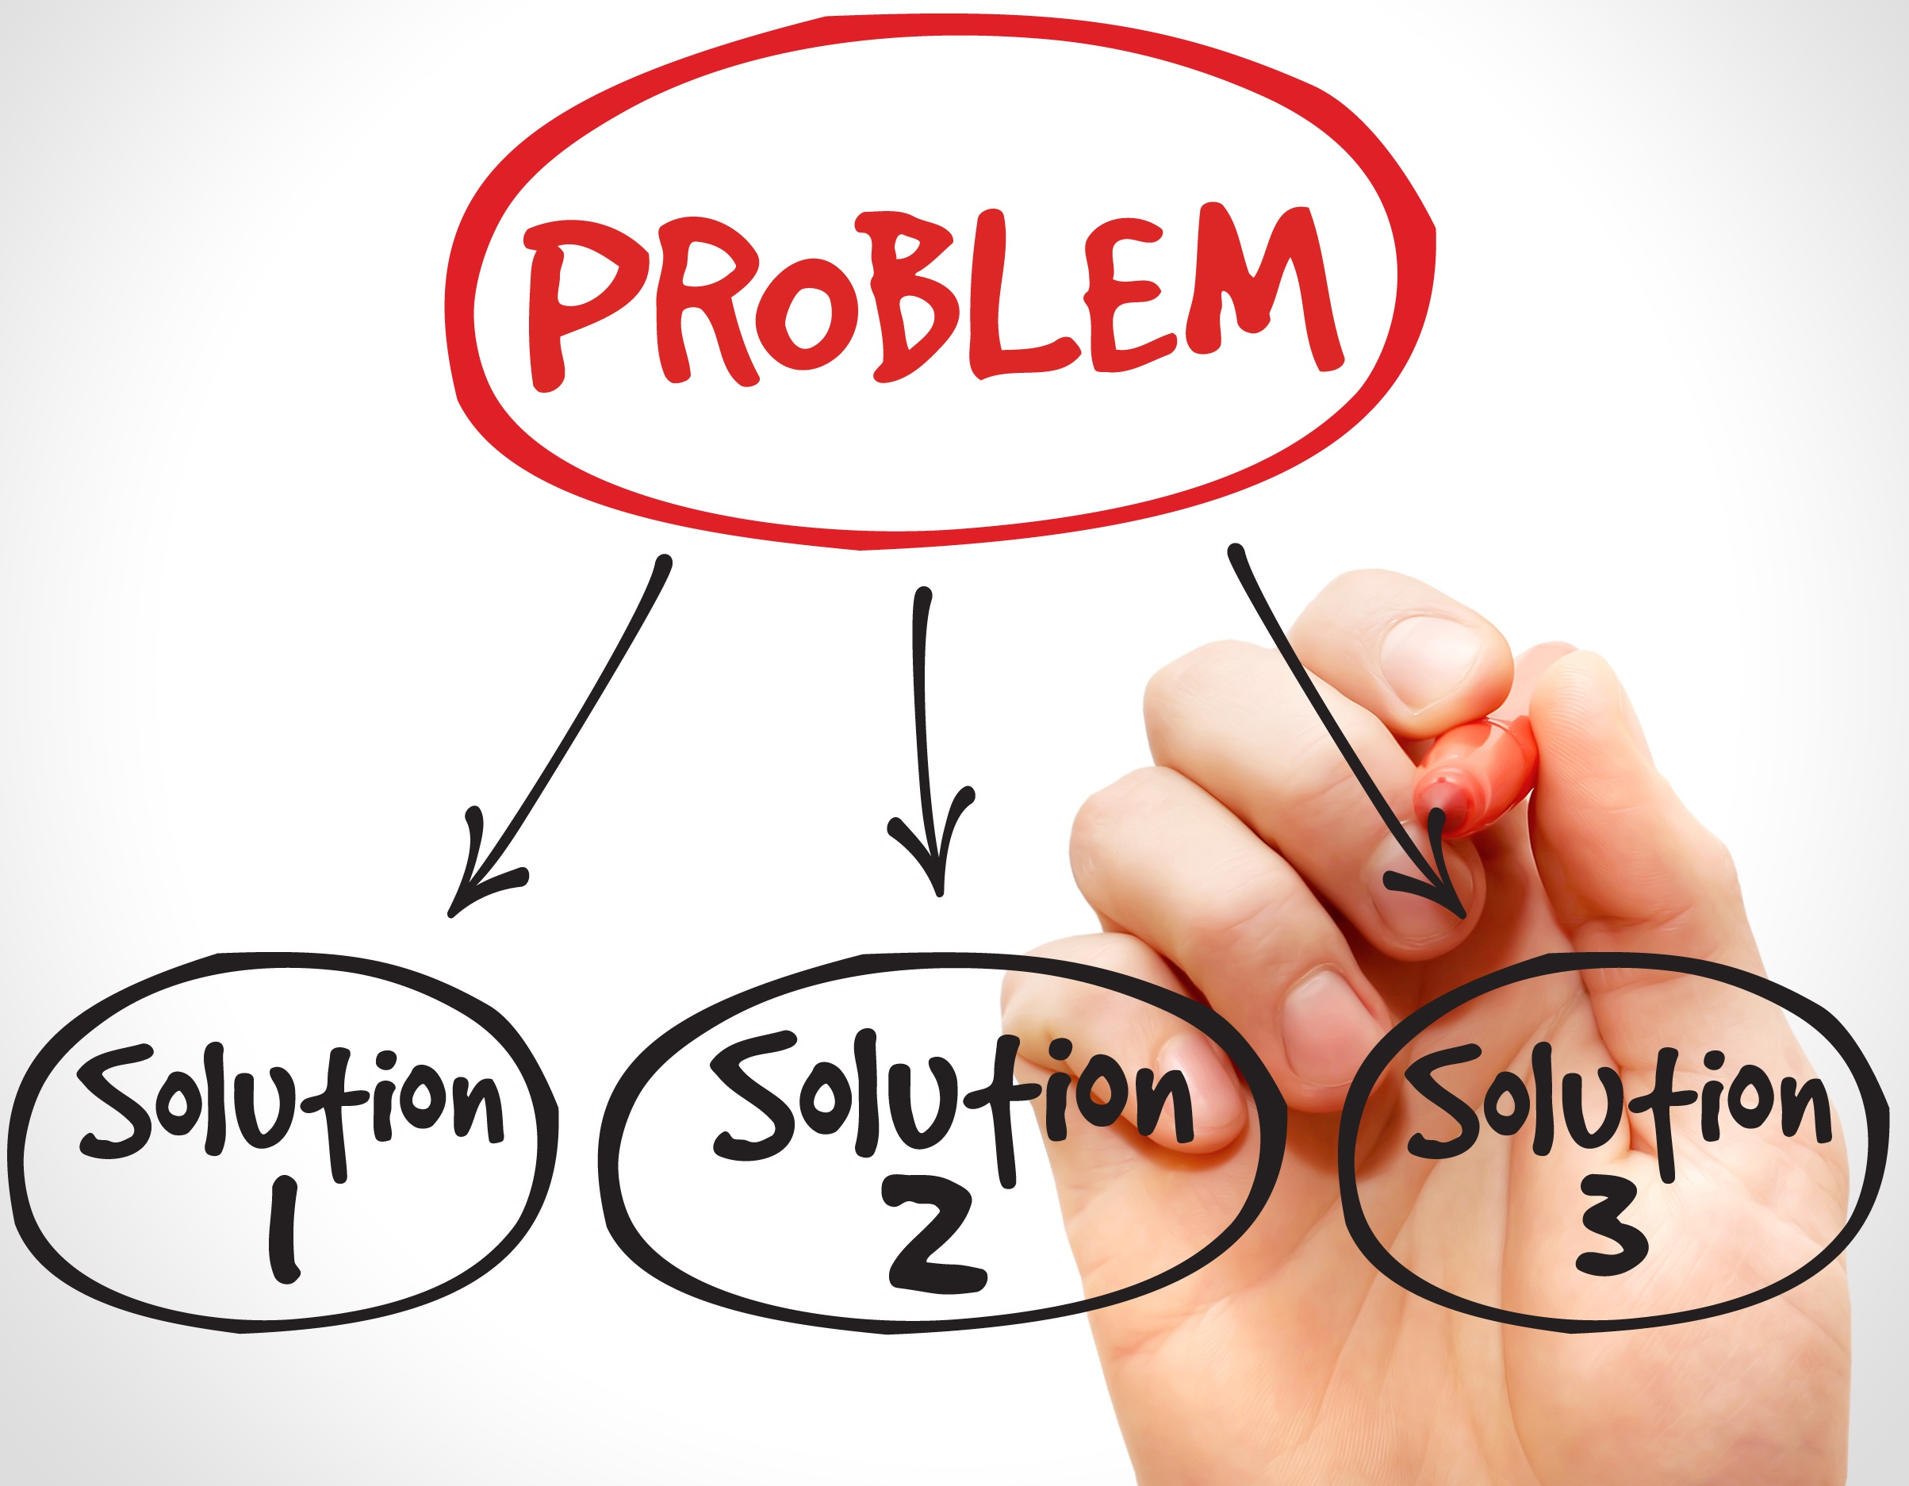
Engineering in real life

Slide 5
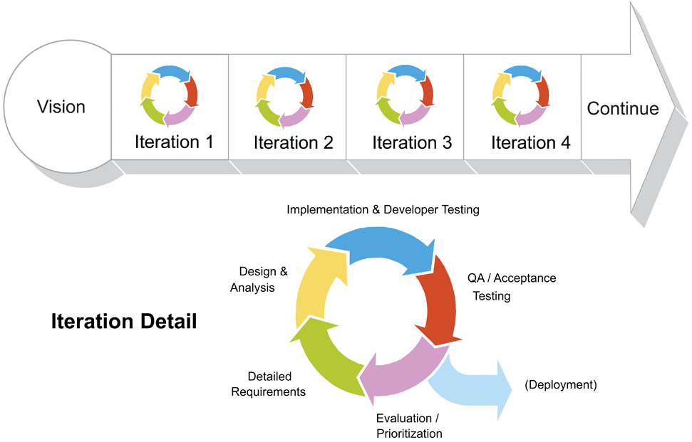
Real engineering
Redesign
Source: http://scrumreferencecard.com/scrum-reference-card/

Slide 6
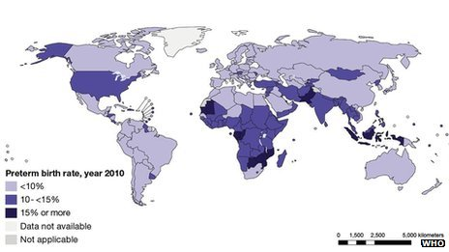
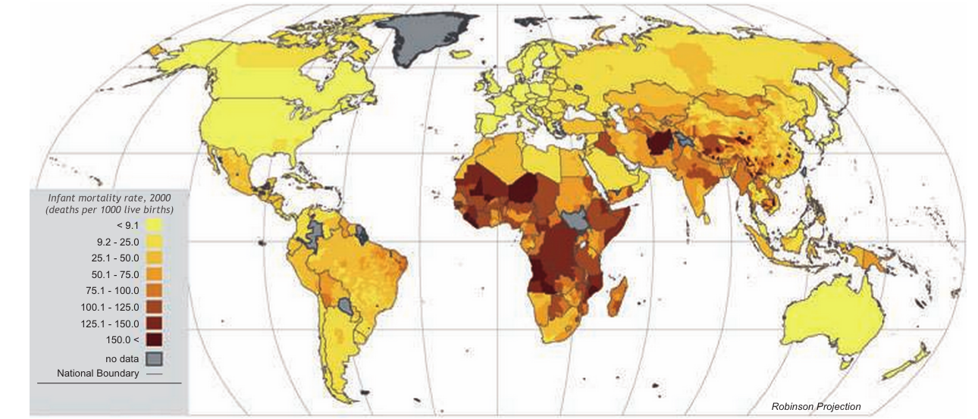
Analyze data

Slide 7
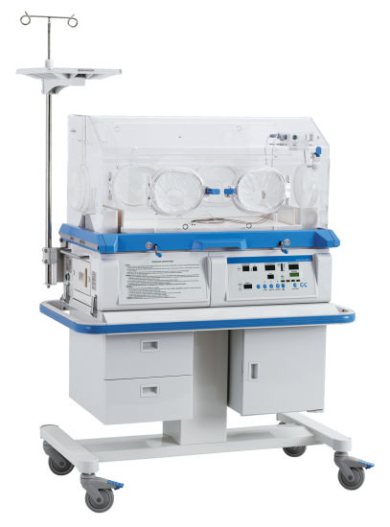
The problem
Premature infants need warmth of an incubator

Slide 8
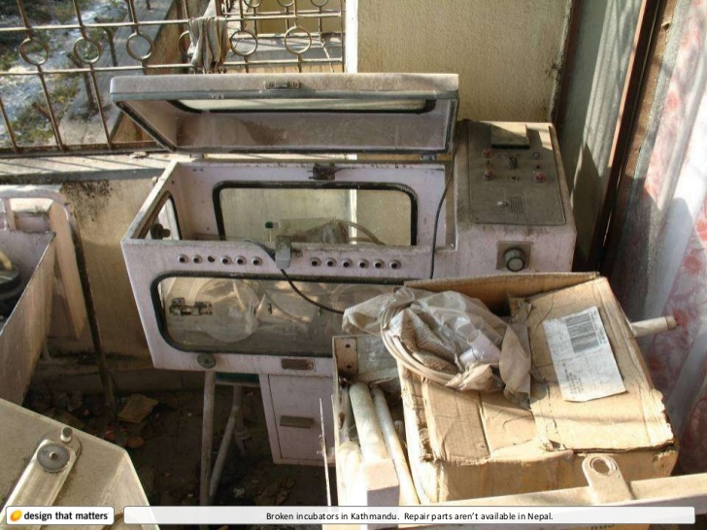
The problem
But more complex then just getting incubators

Slide 9
Overview of Unit
Need to create heat
Need to contain heat (Insulator)
Need to regulate temperature (Phase change material)

Slide 10
Overview of Unit
Need to create heat
Experiment on effectiveness of reactions
Modeling chemical reactions
Modeling what heat is
Create heating pack

Slide 11
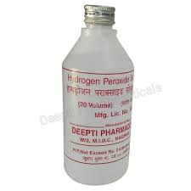
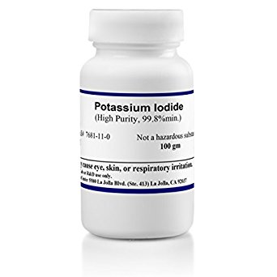
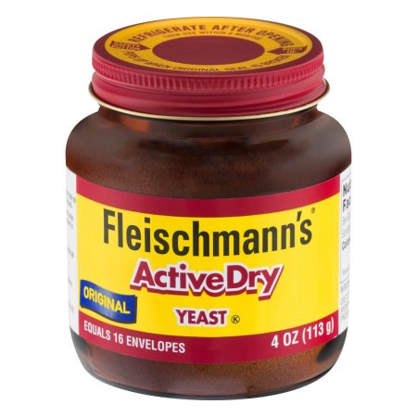
Supplies – chemical reaction
Inexpensive Version
Pure reactants
Peroxide (for hair)
Yeast
Hydrogen Peroxide
Potassium Iodide

Slide 12
The reaction
Yeast or Potassium Iodide is a catalyst

Slide 13
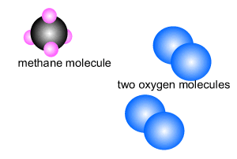
Chemical Reactions
When molecular bonds break, often energy (as heat) is given off

Slide 14
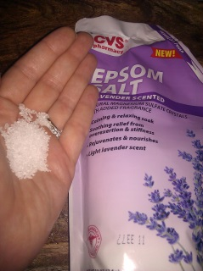
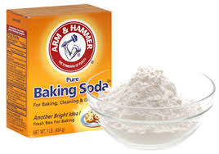
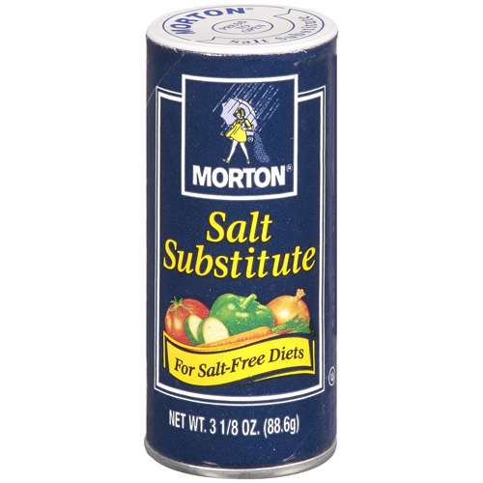
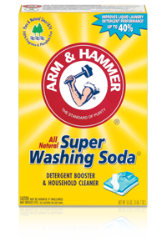
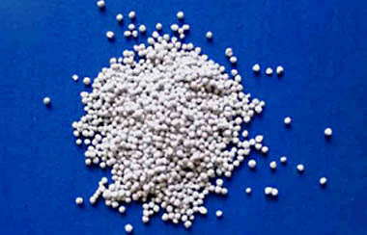
Supplies – Dissolution reactions
NaHCO3 (Baking soda)
MgSO4 (Epsom Salts)
KCl* (Salt substitute)
Na2CO3 (Washing Soda)
CaCl2 (Road Salt)

Slide 15
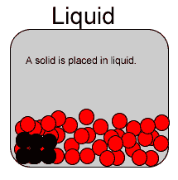
Dissolution reaction
A solid dissolving in a liquid breaks bonds in the solid

Slide 16
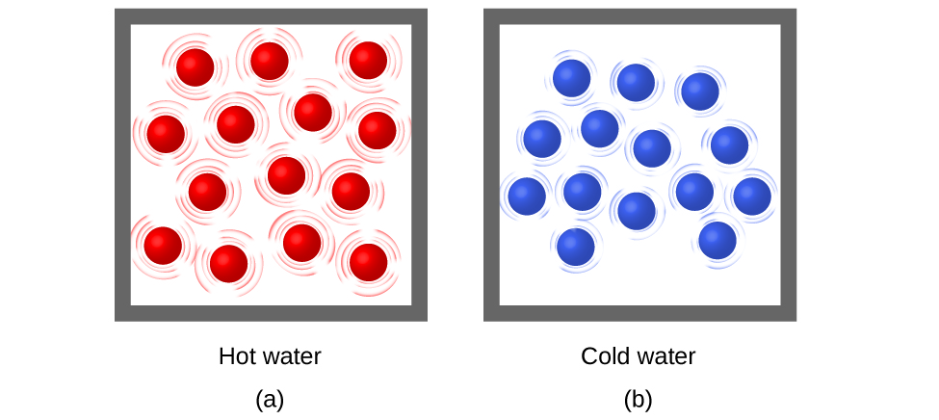
What is heat
Heat is speed of movement of molecules and atoms

Slide 17
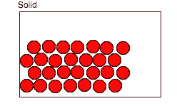
Phase Change
Heat is the movement of atoms and molecules
Speed of that movement = heat

Slide 18
Overview of Unit
Need to create heat pack
Need to contain heat (Make Insulator)
Need to regulate temperature (Phase change material)

Slide 19
Overview of Unit
Need to create heat
Need to contain heat (Insulator)
Black blocks
Construct infant incubator

Slide 20
Black Blocks
Compare the two black blocks.
Block A
Block B

Slide 21
Heat Transfer
Heat Transfer

Slide 22
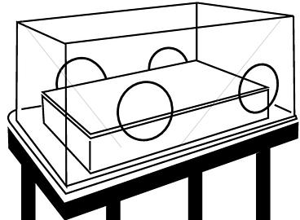
Building Incubator
Building Material Price List
Plan
Pink Foam Board (20cm x 20cm) $15/piece
Cotton Balls - $10 for 10
Green Foam (10cm x 10cm) $25/piece
Aluminum foil (20cm x 20cm) $10/piece
Plastic Wrap (20cm x 20cm) $15/piece
Bubble Wrap (20cm x 20cm) $20/piece
Task Sheet
Task to be completed (Be specific! For example, use exact dimensions for cutting items) | Person responsible for task

Slide 23
Overview of Unit
Need to create heat pack
Need to contain heat (Make Insulator)
Need to regulate temperature (Phase change material)

Slide 24
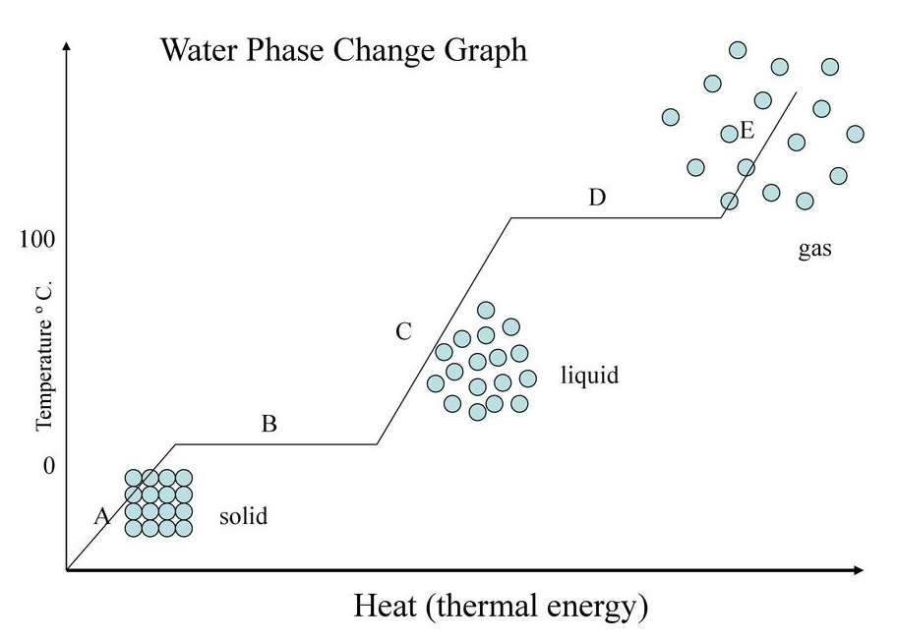
Phase change

Slide 25
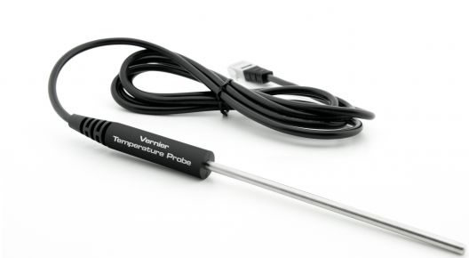
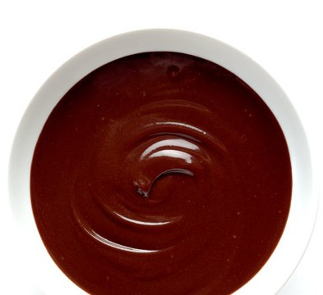
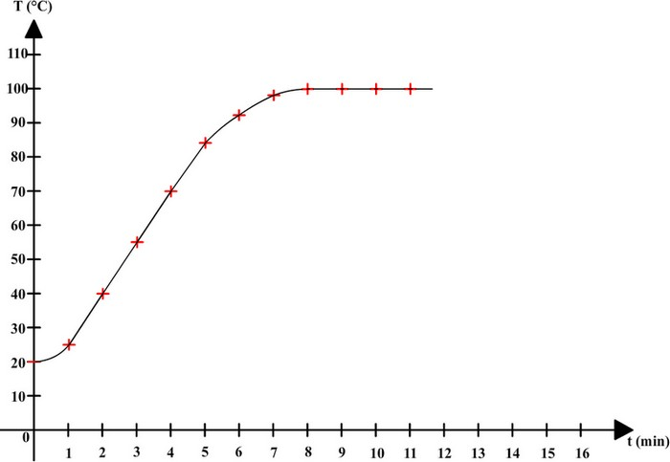
Chocolate Fondue

Slide 26
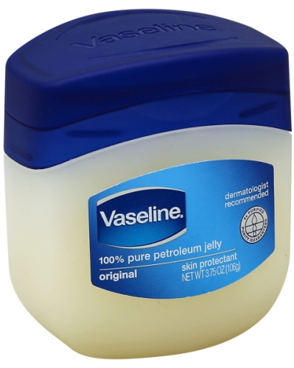
Petroleum Jelly
Changes phase around body temperature

Slide 27
Redesign Incubator
Building Material Price List
Plan
Pink Foam Board (20cm x 20cm) $15/piece
Cotton Balls - $10 for 10
Green Foam (10cm x 10cm) $25/piece
Aluminum foil (20cm x 20cm) $10/piece
Plastic Wrap (20cm x 20cm) $15/piece
Bubble Wrap (20cm x 20cm) $20/piece
Task Sheet
Task to be completed (Be specific! For example, use exact dimensions for cutting items) | Person responsible for task

Slide 28
More information
Jill Wulff
Jennifer Smith
Jenny Brewer
Joe Muskin
wulffj@cusd305.org
smije@sages.us
brewerj@tuscola.k12.il.us
jmuskin@Illinois.edu
https://docs.google.com/document/d/ 17ycib18DuINhejT3hjarzX2Dy149vvVXUCCtGHzzPtw/edit?usp=sharing

